Slide 1
Apprenticeships
JJ Wheatly

Slide 2
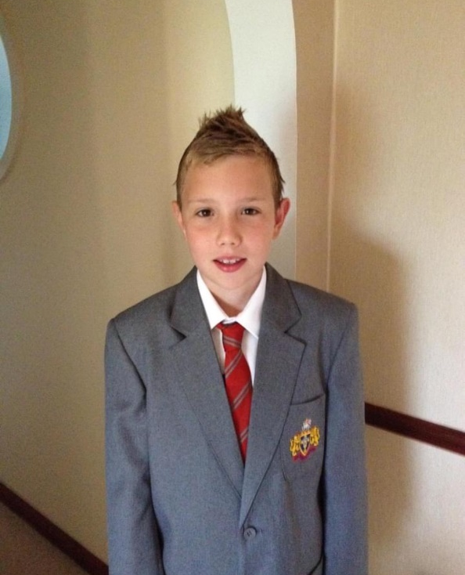
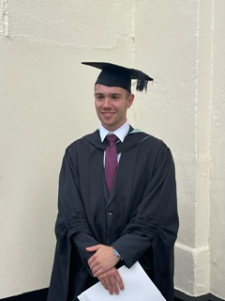
Who am I?
Former NHGS Student and GSK Apprentice
Joined in 2012 and left in 2019!
Studied Maths Economics and Sociology (A-Level)
Played as much football as possible
Started September 2019
Business and Supply Chain Apprentice
BSc Hons – Professional Practice in Supply Chain Leadership
NHGS
GSK

Slide 3
Why I chose an apprenticeship at GSK
Experience working in a global company ( FTSE 100).
Fully qualified within my desired field.
Wide network of Early Talent
Money!!!

Slide 4
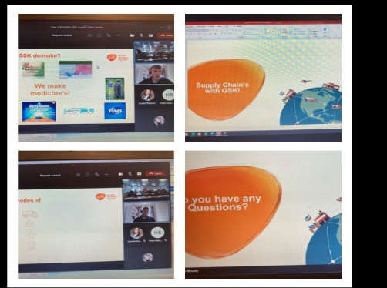
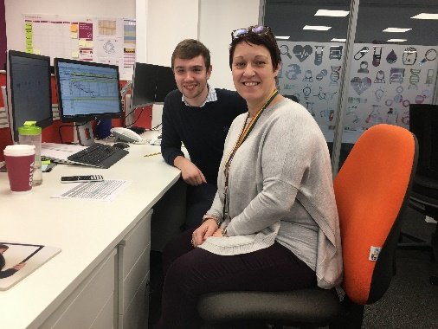
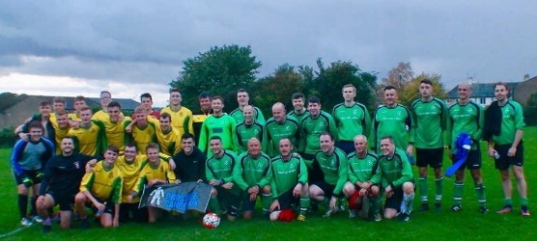
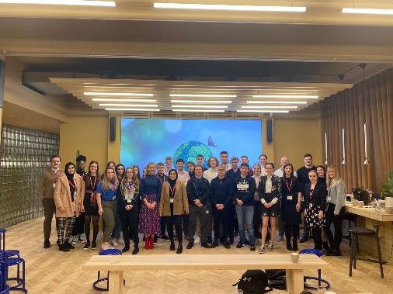
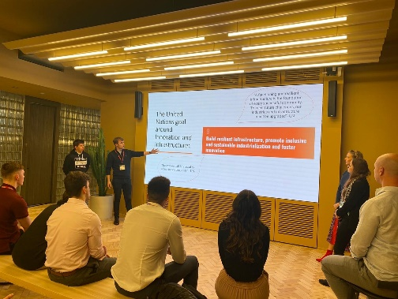
Life as an apprentice
Logistics Rotations
Landing Role
I&D Production Scheduling
Sep 2019
Vials Production Scheduling
Sep 2020
Material scheduling
July 2021
Raw Material & API scheduling
April 2022
Apprenticeship
Supply Chain Leadership Degree – University of Hull
Careers Fairs
Resilience, Outward Bound and Fieri events.
SLT Job Swap
CTC group – Sustainability event/ National Apprenticeship week activities
Charity and Community events
Development
Confidence
Presenting/running meetings
Teamwork
Time management
Organisation
Accountability
Living!

Slide 5
Applications
Understand the different stages of the application process.
Take your time.
Reach out to people to help
Do your research.
Use the process to understand the company you are applying for.
BE YOURSELF!!!!

