Slide 1


Getting you ready for the summer exam series:
A student guide

Slide 2

Summer exams 2025
The exam boards have a set of rules which all students must follow when taking their exams. These rules cover:
  Before the exam
    You need to know which exams you have been entered for, and when they take place
  During the exam
    You need to know the rules you need to follow in the exam room
  After the exam
    You need to know when and how you will receive your results, and what to do if you think an error might have been made with your grade(s)
Notes:
What we’re going to cover in this session

Slide 3
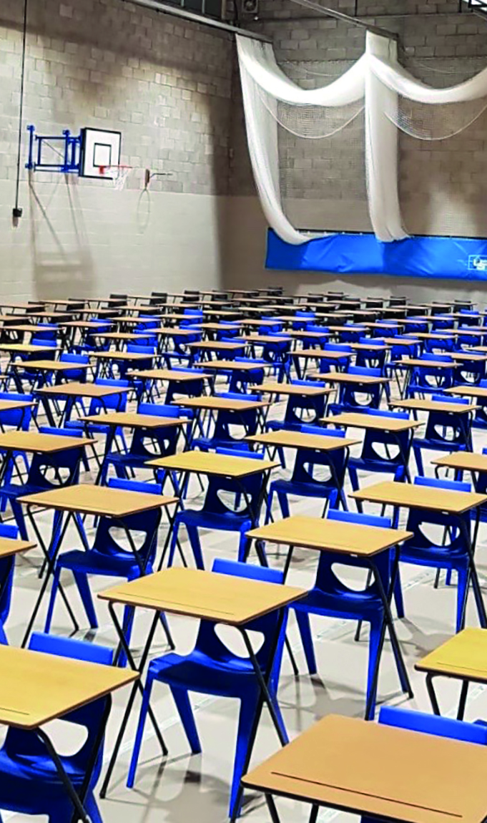
Exam entries
You will be provided with information about the exams you are taking this on Edulink
Accuracy. Tell the exams officer if:
  you think we have been entered for an incorrect exam
  you have not been entered for an exam which you think you should be sitting
  your personal details are incorrect
Exam day arrangements
  Be aware of the date, time and location (room) of all your exams /assessments
Exam clashes
  Ensure that know what to do if you have two or more exam papers timetabled at the same time (this is known as a timetable clash)
Notes:
Check what’s on Edulink for you and let me know if you can foresee any issues

Slide 4

Contingency sessions
There are no exams taking place on the following days/sessions, but you will be expected to make yourself available at these times in case they are used in the event of an emergency:
  Thursday 11 June (afternoon)
  Wednesday 25 June (all day)
Notes:
You will not have exams scheduled for these times unless you have a clash.
You MUST be available just in case an exams has to move into these slots.

Slide 5
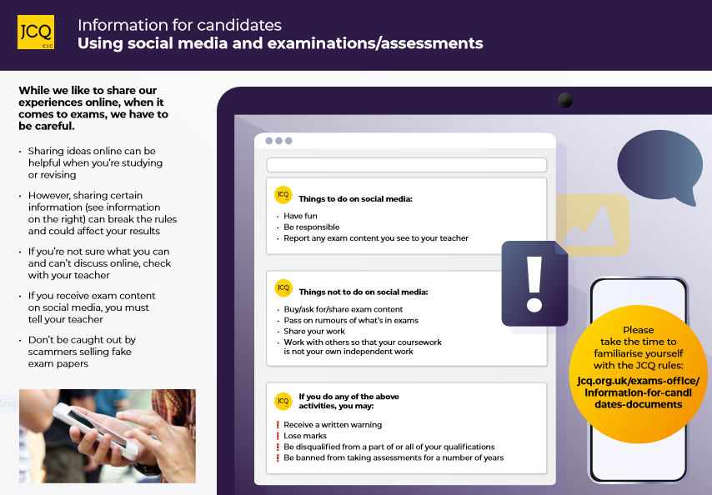

Social media poster
DO NOT COMMENT ON OR DISCUSS THE CONTENT OF THE QUESTION PAPER ON SOCIAL MEDIA
Notes:
Do not talk about exams on social media
Boards are looking for these types of thing and will deal with it.
If you spot anything on social media you should let your teacher or me know.

Slide 6
The Exam Day
You must be aware of the following before your exams:
  In which room(s) your exams will be taking place
  What time each of your exams will be starting (and finishing)
  Where you will be sitting during each exam
  Where your personal belongings will be kept, for example your bag, mobile phone etc. Outside the exam room, hand your phone in for safe keeping.
Notes:
BE ON TIME
People whoa re consistently late may not be allowed to sit their exams as they are compromising the security of the examination for all students in the country and causing a disturbance to other candidates already sitting their exams at NHGS.

Slide 7
What you need to do if you are late for an exam
You must be on time for all of your exams
However, if you are/you think you will be late for an exam, follow these steps:
Step 1: Telephone the school and ask to speak with the exams officer – Mrs Manley
Step 2: Follow the instructions given by the exams officer
Step 3: Turn off your mobile phone and any other communication device
Step 4: When you arrive at school go to reception and explain that you are late and that you need to see the exam officer immediately
Step 5: Your exams officer will give you the full instructions for the exam, and answer any questions, before you are allowed to begin your exam

Slide 8
What you need to do if you are ill on the day of an exam
If you are feeling unwell on the day of an exam, follow the steps below
Step 1: Telephone the school and ask to speak with the exams officer
Step 2: Follow the instructions given by the exams officer
Step 3: Try and get some evidence to prove your illness (e.g. a doctor’s note)
Step 4: Consider your options carefully
You cannot defer your exam or use your mock grades to get a certificate.
Notes:
How is a grade decided
Relying on other people to get you a good grade
Often better to come in and then decide after discussions with your teachers or exam staff.
Special consideration.

Slide 9

What is Special Consideration?
Special Consideration can be applied for candidates if they are unwell or experience adverse issue or event has had or is reasonably likely to have had, a material effect on a candidate’s ability to take an assessment or demonstrate their normal level of attainment in an assessment. For example, a candidate who has temporarily experienced illness, injury or some other event outside of their control at the time of the assessment.
Special consideration will normally be given by applying an allowance of additional marks to each component affected within a specification. The size of the allowance depends on the timing, nature and extent of the illness or misfortune. The maximum allowance given will be 5% of the total raw marks available in the component concerned, including coursework/non-examination assessment.
Notes:
Special consideration can only go some way to assist a candidate affected by a potentially wide range of difficulties, emotional or physical, which may influence performance in their assessments. It cannot remove the difficulty faced by the candidate. This means that there will be some situations where candidates should not be entered for a qualification or a unitised examination. This is because only minor adjustments can be made to the mark awarded. To make larger adjustments would jeopardize the standard of the qualification.
Examples:
5% - Terminal illness of the candidate
4% - Life threatening illness of candidate or member of immediate family
3% - Broken limbs
2% - Illness at the time of the exam
1% - hay fever (bad enough to have a detrimental affect on performance) / medicated stress or anxiety

Slide 10
Access Arrangements
The special educational needs co-ordinator (SENCo), will inform you of how your access arrangement will be delivered on the day of the exam
Access arrangements include:
  Use of a reader
  Use of a scribe
  Extra time
  Supervised rest breaks
Notes:
You will know what you are entitled to.
If you are unsure please speak to SEND team in SSA before your exams.
If your AA are not available to you please don’t be shy, alert an invigilator and we can remedy it easily.

Slide 11

Exam room posters
You are not allowed to bring the following into the exam room as they are potential technological / web enabled sources of information:
Mobile phone/smartphone
Smartwatch
Analogue watch
AirPods
Earphones/earbuds
iPod
MP3/4 player
Memory sticks
Notes:
All exam boards have emailed exams officers to highlight the issue of mobile phones this year and have said they will be enforcing the sanctions as appropriate.
YOU HAVE BEEN WARNED
You will have the opportunity to hand anything in before you enter the room so check your pockets and hand anything and everything in before you enter the room.
DO NOT RISK IT

Slide 12
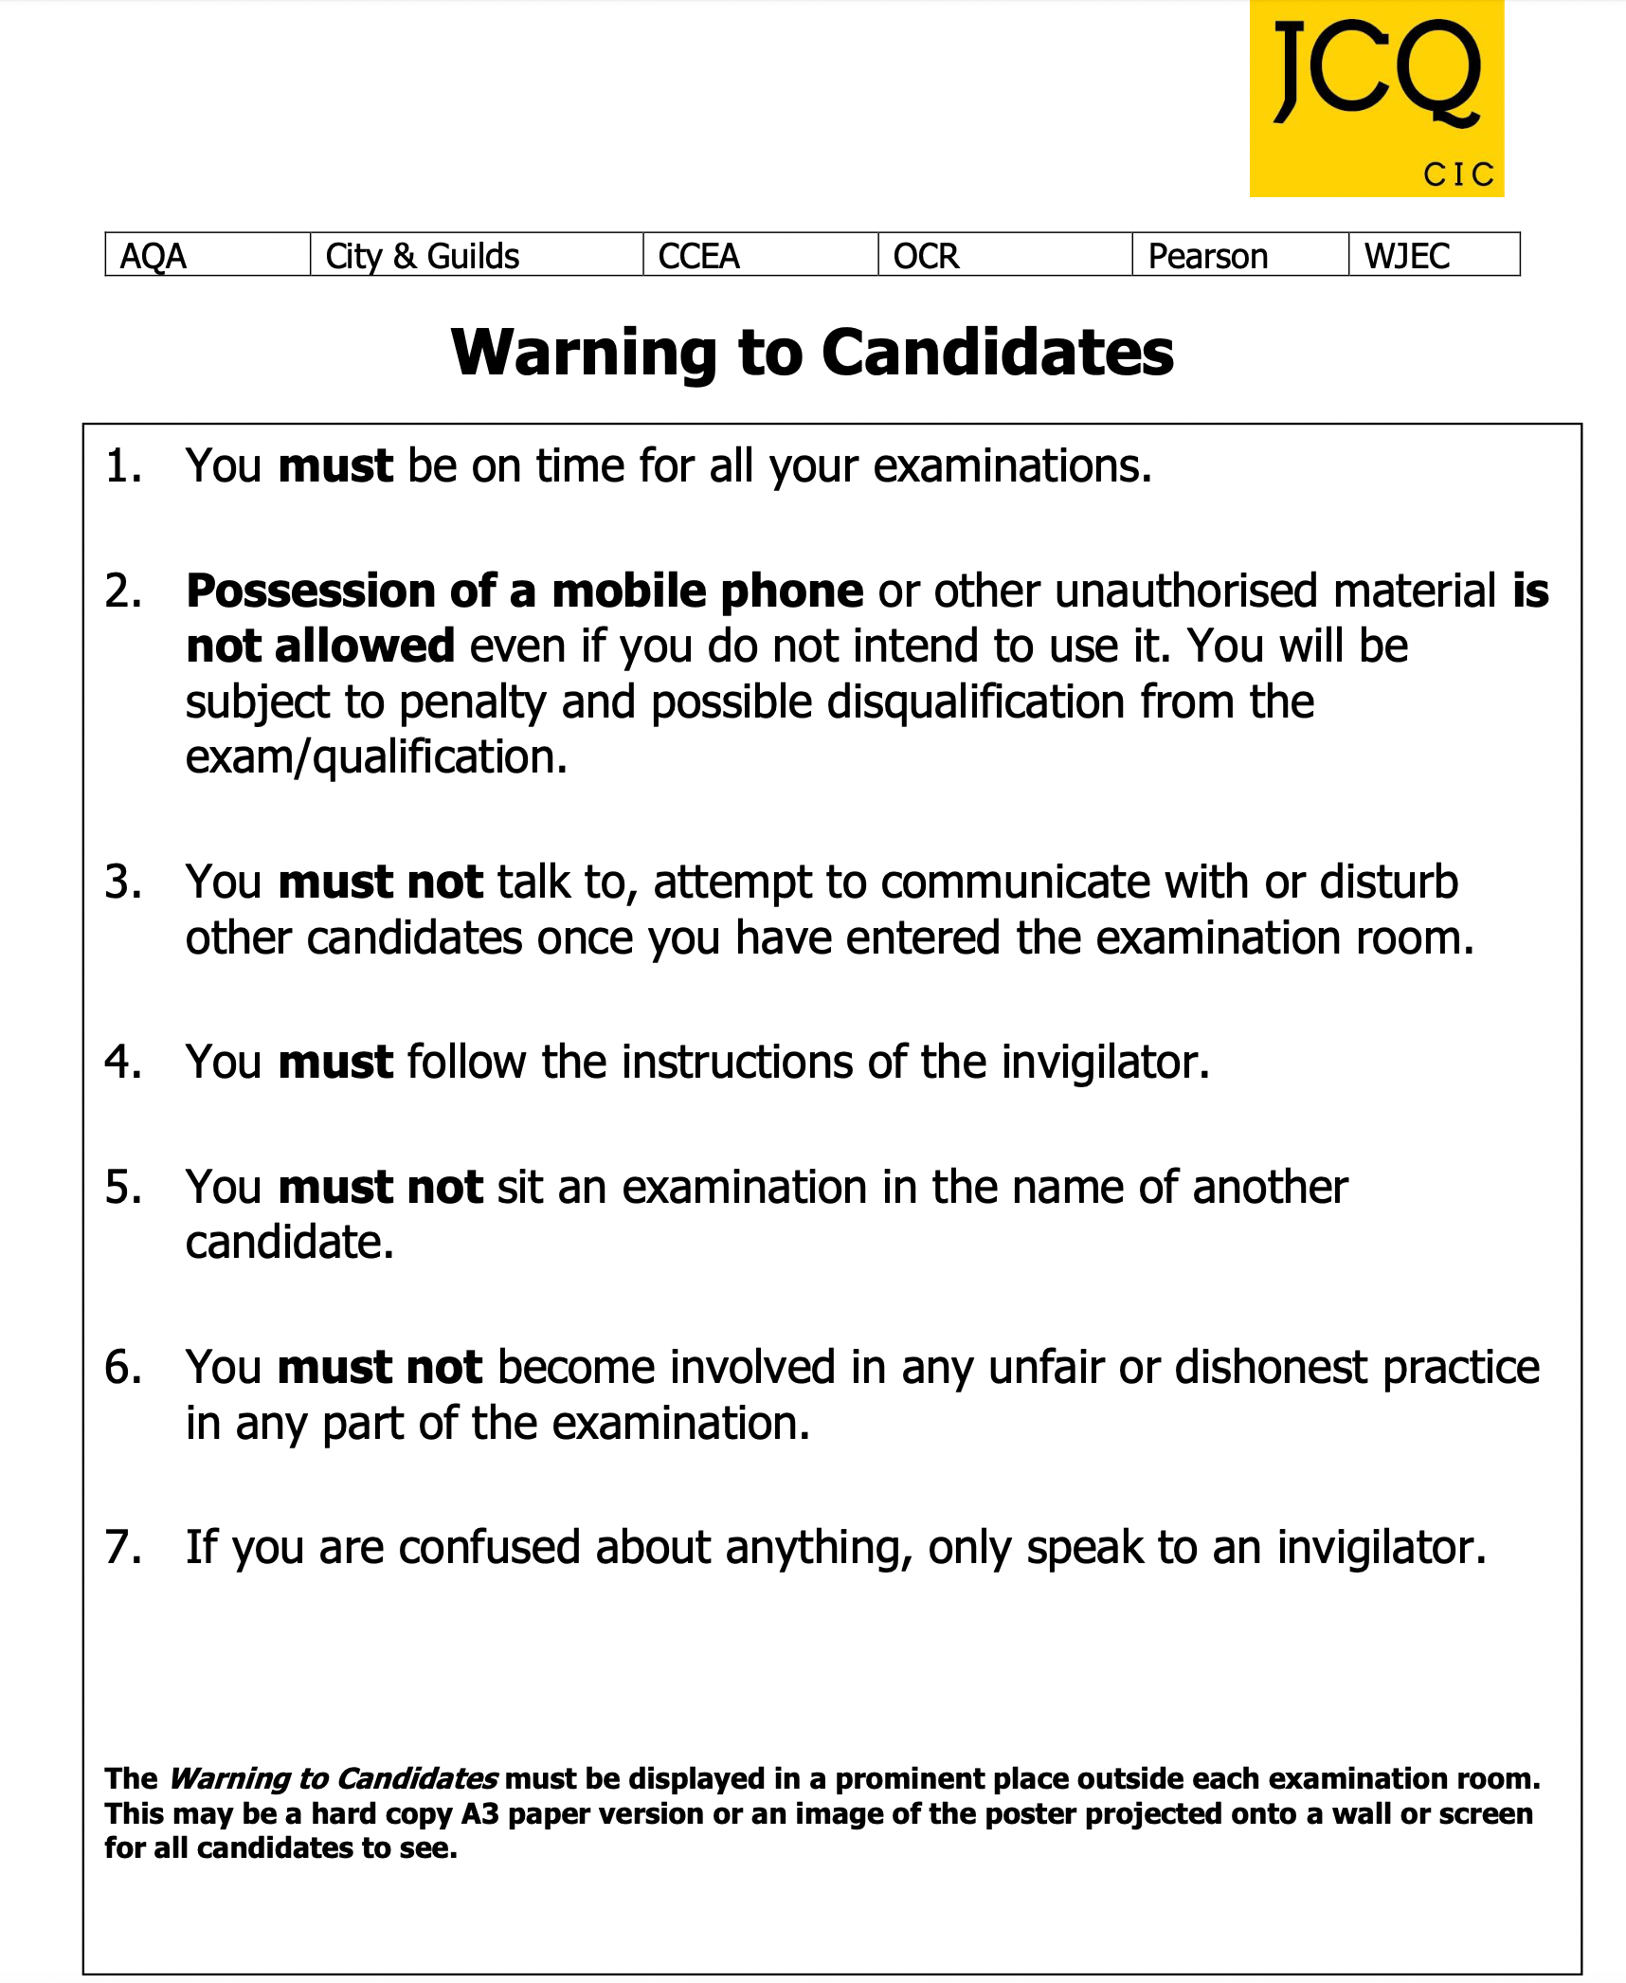
Exam room posters
In particular, note the following:
Possession of a mobile phone, even if you do not use it, is not allowed and may be subject to penalty, including possible disqualification
You are under formal exam conditions from the the moment you enter the room in which you will be taking your examination(s) until the point at which you are permitted to leave
You must follow the instructions of the invigilator
If you do not follow these instructions you are committing malpractice
Notes:
One you pass the threshold you are in an exam.
Behave like you are in an exam.
Anything which falls outside the rules or could jeopardise the integrity of the exams will be reported.

Slide 13
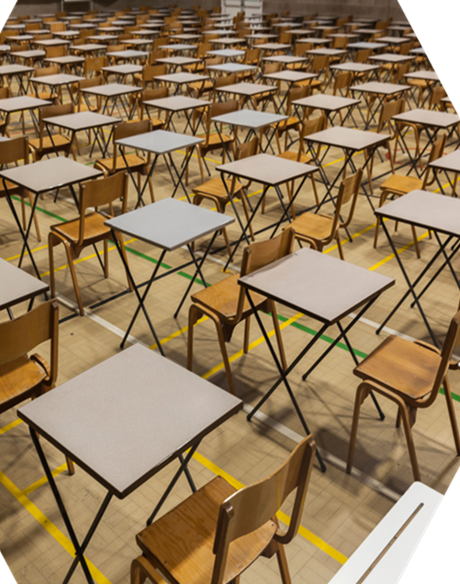
What are formal exam room conditions?
Formal examination/exam room conditions are:
  Not talking to other candidates
  Not disturbing other candidates
  Not communicating with other candidates
You are under formal examination conditions from the moment you enter the exam room in which you will be taking your examination(s) until the point at which you are permitted to leave
If you talk to, disturb and/or communicate with other candidates as you enter or leave the exam room (as well as the whole time you are in the exam room), this is malpractice and will be reported to the awarding body who will decide whether to penalise you which may include disqualification
Notes:
Not communication – not looking at anyone except the invigilator or exam staff.

Slide 14

The role of the invigilators
Each exam room will have at least one invigilator
Awarding bodies insist that invigilators must follow follow strict rules and regulations during exams
Invigilators must record any irregular incidents which occur in the exam room (e.g. if someone feels unwell, requires the toilet or falls asleep etc.)
If you behave in a suspicious manner the invigilator will approach you and ask you to stop
If you misbehave, the invigilator will warn you that you may be removed from the exam room
You are committing malpractice if you do not follow the invigilators instructions
YOU MUST FOLLOW THE INSTRUCTIONS OF THE INVIGILATOR. FAILURE TO DO SO MAY RESULT IN A PENALTY WHICH COULD INCLUDE POSSIBLE DISQUALIFICATION
Notes:
This information is sometimes requested by the board if they suspect cheating, they will be looking for any opportunity you may have had to cheat.
Try not to use the toilet unless you absolutely have to.
Go straight before the exam and don’t drink too much in the exam.

Slide 15
Exam room regulations
PLAY THE INSTRUCTIONS FOR CANDIDATES VIDEO:
Information for Candidates 2024/2025

Slide 16
Exam room conditions
How each exam room will be set up
How you will enter the exam room
Formal exam conditions apply
Follow the invigilator’s instructions
Exam information
Completing the front of your answer booklet
Additional answer sheets/ booklets
Once you have entered the exam room:
Do not talk to other candidates
Do not disturb other candidates
Do not communicate with other candidates
Your invigilator will ensure that the following are in place inside/outside the exam room:
Exam room posters
Adequate room conditions (heating, lighting, ventilation, noise etc.)
Clock
Relevant exam information displayed
Centre number
For each exam:
Subject title
Paper number
Starting & finishing times
Date

Slide 17
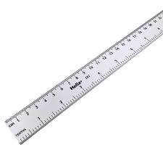
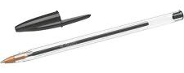


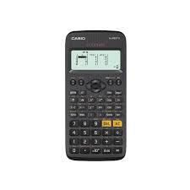
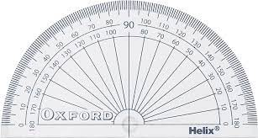

What materials should you bring to an exam
You must bring the following materials with you to every examination:

Slide 18
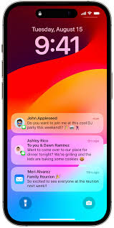
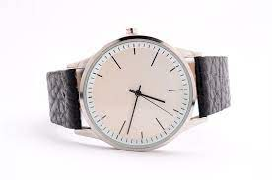
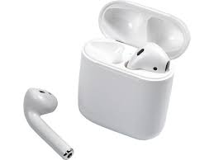
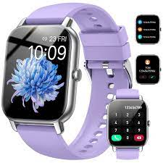
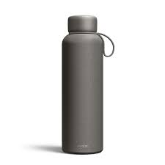
What material is not allowed in the exam room

Slide 19
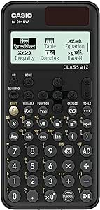

Calculators
How a calculator can/cannot be used in an exam
During an exam, a calculator must not be able to offer any of these facilities:
language translators
symbolic algebra manipulation
symbolic differentiation or integration
communication with other machines or the internet
During an exam, a calculator must not give access to pre-stored information. This includes:
databanks
dictionaries
mathematical formulae
text
Your Maths teacher will explain how a calculator can/cannot be used in an exam

Slide 20

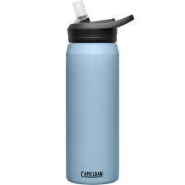
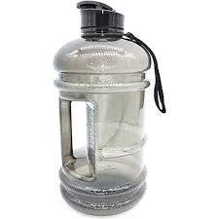


Water bottles
Water bottles must be transparent with all labels removed
This includes transparent, reusable plastic bottles
The invigilator may ask you to take off the lid if this is large enough to hide notes
Notes:
ASDA £1-£3

Slide 21
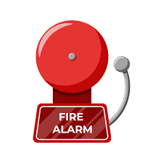
Emergency evacuation of the exam room
If there is an emergency, such as a fire alarm, the exam room will be evacuated
This video shows how your invigilators are instructed to evacuate the exam room
You must follow the invigilator’s instructions
PLAY THE DEALING WITH EMERGENCIES VIDEO:
https://youtu.be/TxzZhK8R0m0

Slide 22
What is malpractice?
Any form of communication
Not following the instructions of an invigilator
Disruptive behaviour in the exam room (including the use of offensive language)
Bringing unauthorised notes, study guides and personal organisers into the exam room
Mobile phone or similar electronic devices (including a memory stick, smartphone, watch/smartwatch, AirPods, earphones/earbuds)
Malpractice
Exchanging, obtaining, receiving, or passing on information which could be exam related (or attempting to)
Introducing unauthorised material into the exam room
Undermining the integrity of the exams/ assessments
Breaches of exam conditions
Offences relating to the content of the candidates’ work
Writing/drawing offensive or obscene material
Copying from sources without referencing (including the internet and Artificial Intelligence tools) and misusing technology
Sharing, copying work or allowing your work to be copied
Behaving in a way in which is not allowed in the exam room
Sitting the exam in another person’s name
Using social media to exchange and spread real or fake exam material

Slide 23
Examples of malpractice and the penalties which may be applied
Offence | Warning | Loss of marks on that paper | Loss of marks on all papers in that subject
Bringing notes in the wrong format or prohibited annotations into the exam room | Notes/annotations go beyond what is permitted but do not give an advantage; content irrelevant to subject | Notes/annotations are relevant and give an unfair advantage | Notes/annotations introduced in a deliberate attempt to gain an advantage
Mobile phone or similar electronic devices (including iPod, MP3/4 player, memory sticks, smartphone, smartwatch, AirPods, earphones and headphones) | Not in the candidate’s possession but makes a noise during the examination | In the candidate’s possession but no evidence of being used by the candidate | In the candidate’s possession and evidence of being used by the candidate

Slide 24
Examples of malpractice and the penalties which may be applied
Offence | Warning | Loss of marks on that paper | Loss of marks on all papers in that subject
A breach of the instructions or advice of an invigilator, supervisor, or the awarding body in relation to the exam rules and regulations | Minor non-compliance: e.g. sitting in a non-designated seat; continuing to write for a short period after being told to stop | Major non-compliance: e.g. refusing to move to a designated seat; significant amount of writing after being told to stop | Repeated non-compliance
Disruptive behaviour in the examination room or assessment session (including use of offensive language) | Minor disruption lasting a short time; calling out, causing noise, turning around | Repeated or prolonged disruption; unacceptably rude remarks; being removed from the exam room; taking another’s possessions | Warnings ignored; provocative or aggravated behaviour; repeated or loud offensive comments; physical assault on staff or property

Slide 25
Examples of malpractice and the penalties which may be applied?
Offence | Warning | Loss of marks on that paper | Loss of marks on all papers in that subject
The inclusion of offensive or obscene material in scripts, controlled assessments, coursework, non- examination assessments or portfolios | Isolated offensive words or drawings | Frequent offensive words or drawings; isolated obscenity or offensive comments directed at an individual or group | Frequent obscenities; discriminatory language, remarks or drawings directed at an individual or group
Copying from another candidate or allowing work to be copied (including the misuse of technology) | Lending work not knowing it would be copied | Permitting examination script/work to be copied; showing other candidates’ answers | Copying from another candidate’s script, controlled assessment, coursework, non- examination assessment; borrowing work to copy

Slide 26

Leaving the exam room
You should try not to leave the room as it disturbs other candidates and you will not have this time added back on. Students who have access arrangements for medical or rest breaks will be allowed to have this time added back onto the duration of the exam.
Any incidents within the exam room will be noted by the invigilator on the invigilation record log, this includes toilet breaks. These notes are sometimes requested by the exam board if they suspect malpractice.
If you finish before the end of the exam and you want to leave early, you will not be allowed to leave until the actual finishing time

Slide 27
Leaving the exam room:
Extra time candidates
If you have been granted extra time and you finish before the end of your extra time and you want to leave early, you will only be able to leave after you have signed to confirm that it is your decision to leave the exam room and that you cannot return for this exam. If you do not use your full extra time on a regular basis, you could possibly lose this arrangement for your remaining exams

Slide 28
Results
Results will be be available from 8am on results day
A Level 14th August 2025
GCSE 21st August 2025
Members of teaching staff and a careers adviser will be available to help you with any queries you may have.

Slide 29
Reviewing your exam results: The options
Service 1: A clerical re-check. This includes a check that:
  all parts of your script (your answers) have been marked
  marks have been totalled and recorded correctly
Service 2: Review of marking. This includes:
  a review of the original marking to ensure that the mark scheme was applied correctly, and to correct any errors
  a check that all parts of your script (your answers) have been marked, and that marks have been totalled and recorded correctly
Service 3: Review of moderation. This applies to non-examination assessments and coursework and includes:
  a review of the original moderation and sample of candidates’ work to ensure that the assessment criteria was applied fairly, reliably and consistently (this service is not available to individual candidates)
Access to scripts

Slide 30
Requesting a post-results service
A Google form will be shared with students who have requested post results services. You must make payment for the services required on ParentPay before the service is requested. Deadlines and costs will be shared with students towards the end of the exam period.
You must speak to a teacher for advice regarding your results before a post results service is requested as marks and grades can go down as well as up and so grade boundaries need to be carefully considered.

Slide 31
Certificates
Certificates will be available usually from December 2025 – you will be invited to a presentation where you will receive your certificates, If you are unable to attend you can collect them in person or authorise someone else to collect them for you. Parents cannot collect them without your permission.
Certificates are retained in the centre for 12 months from the date of delivery, after this time they will be returned to the board and you will have to request a replacement. This will be at your cost – usually around £45 per certificate.

